Slide 1
Convolutional Neural Networks
CSCI 4360/6360 Data Science II

Slide 2
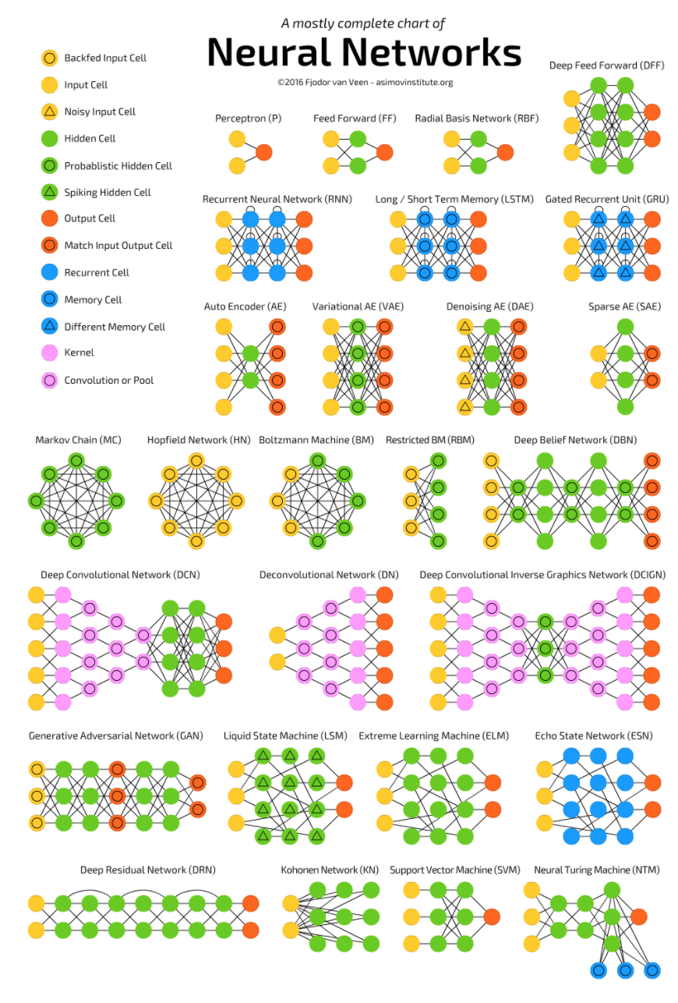
The Neural Network Zoo
http://www.asimovinstitute.org/neural-network-zoo/

Slide 3
The Neural Network Zoo
http://www.asimovinstitute.org/neural-network-zoo/

Slide 4
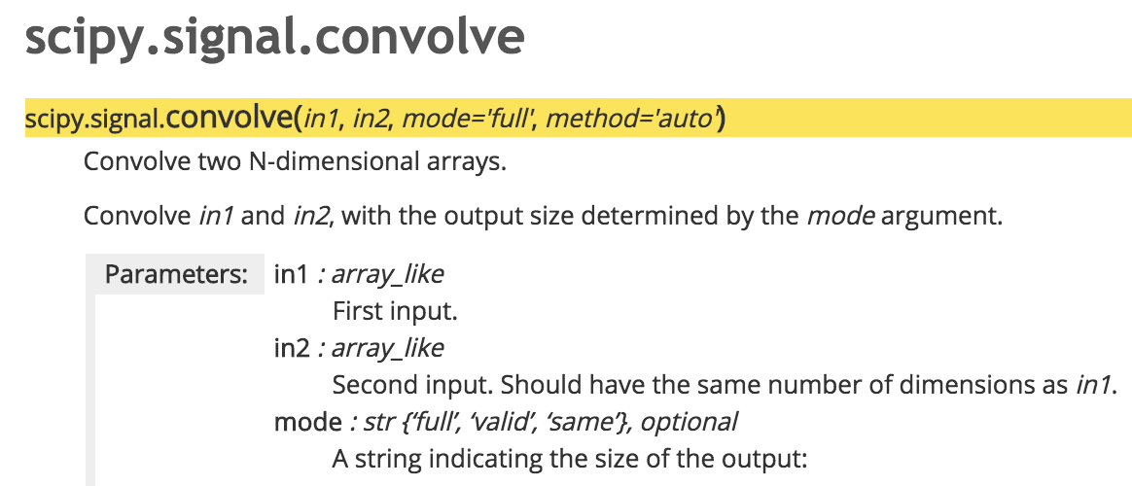
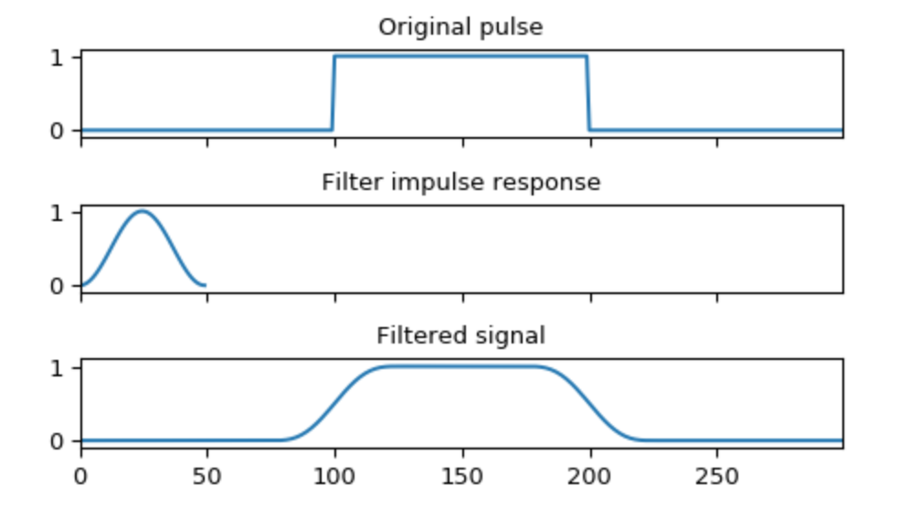

Convolution
Basically a fancy way of saying “multiplication”
Originally devised to make non-differentiable signals differentiable
KDE is related to convolution
For an input function f and convolutional filter g:

Slide 5



Slide 6

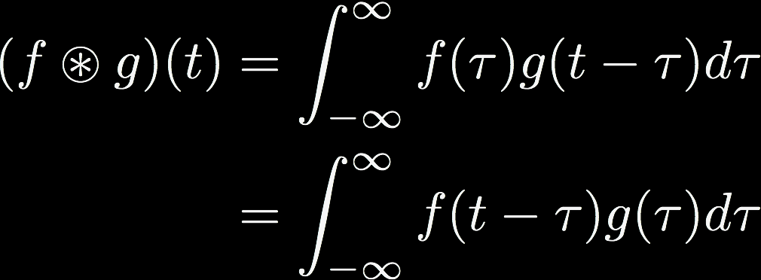

Convolution
Can be viewed as an integral transform
One of the signals is shifted

Slide 7

Convolution in 2D
2D convolutions are critical in computer vision
Basic idea is still the same
Choose a kernel
Run kernel over image
Build a representation of the convolved image (likely an intermediate representation)
Lots of applications

Slide 8
Convolution in 2D
Specific kernels can highlight different image features
This kernel is an edge detector (others can be smoothers, sharpeners, etc)

Slide 9
Convolution in 2D
Works basically the same as 1D
Filter / kernel computes a dot product with underlying pixels
Generates an output
Shift kernel and repeat

Slide 10
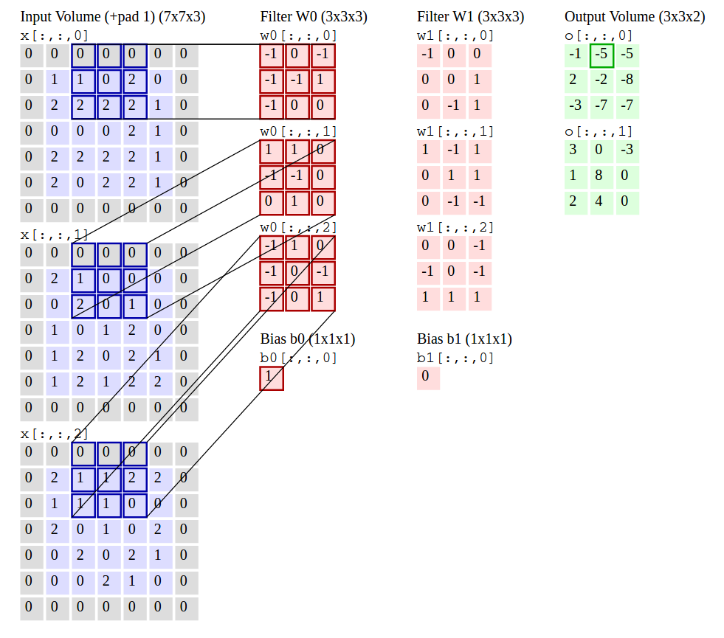
Convolution in 2D
Stride dictates how far the kernel moves after each convolution
Padding is used to help with edge cases
Pictured: stride of 2, padding of 1

Slide 11
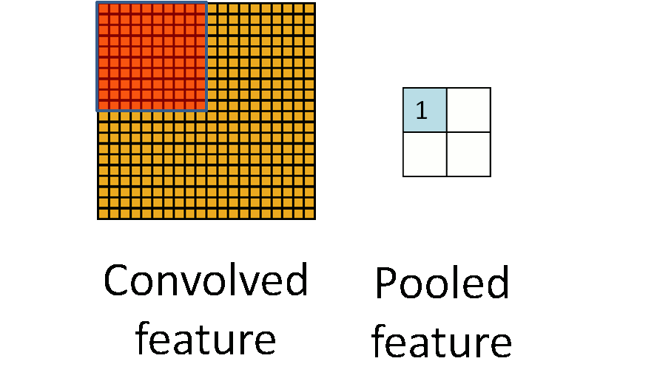
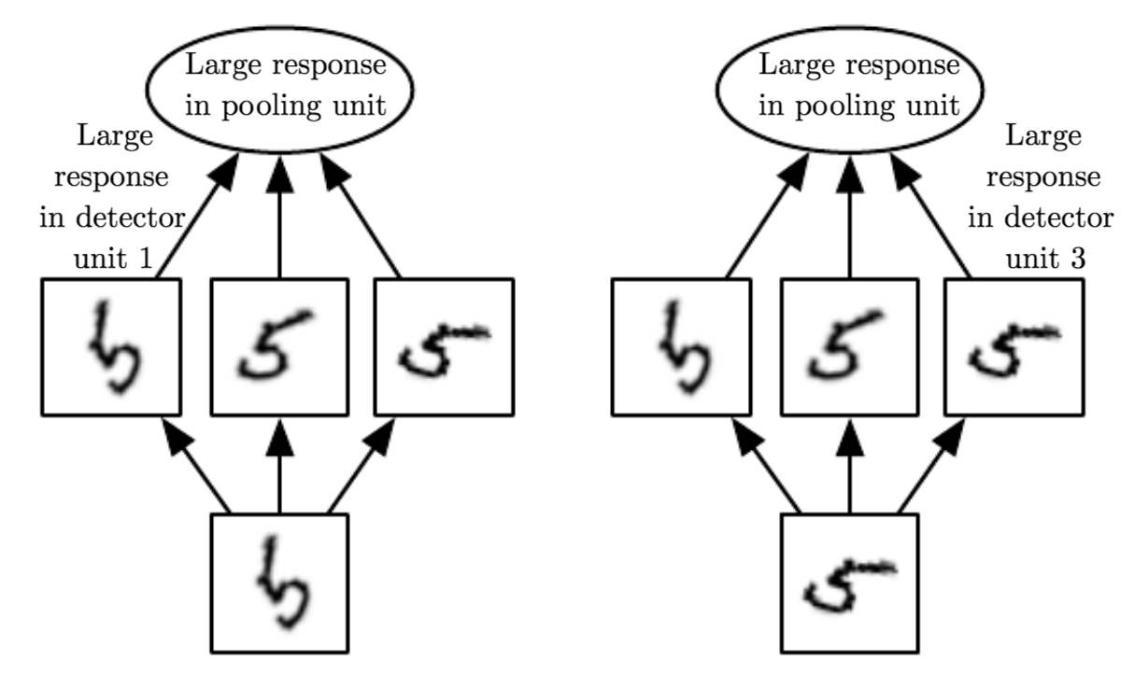
Pooling
Repeated convolutions can generate large intermediate feature maps
“Pooling” is used to reduce dimensionality of feature maps while maintaining most informative features
Mean-pooling, max-pooling
Functions as a regularizer (or an infinitely-strong prior)

Slide 12
Filters
Different filter topologies
Captures long-range pixel dependencies
Very computationally expensive to implement

Slide 13
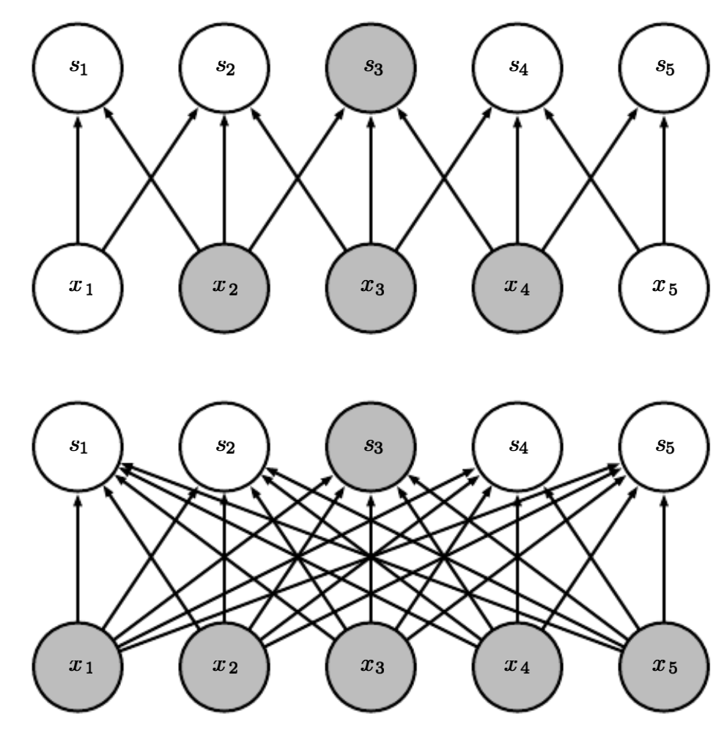
Convolution
Key point: parameter sharing
Images are sparse
Pixel dependencies don’t span arbitrarily large distances
Important effects are local
Instead of a fully-connected network…
…we have one that is more sparsely-connected

Slide 14
Parameter Sharing

Slide 15
CNNs in Practice
Stacked
Convolutions
Pools
Activations
Fully-connected classification layer

Slide 16
CNNs in Practice
Pattern can be repeated several times
Still “deep”, but convolutions are the most important part

Slide 17
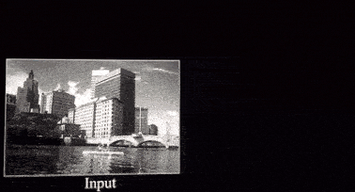
CNNs in Practice
Filters are the things that “search” for something in particular in an image
To search for many different things, have many different filters

Slide 18
CNNs in Practice
Hyperparameters relevant to CNNs:
Kernel size
Usually small
Stride
Usually 1 (larger for pooling layers)
Zero padding depth
Enough to permit convolutional output size to be the same as input size
Number of convolutional filters
Number of “patterns” for the network to search for

Slide 19
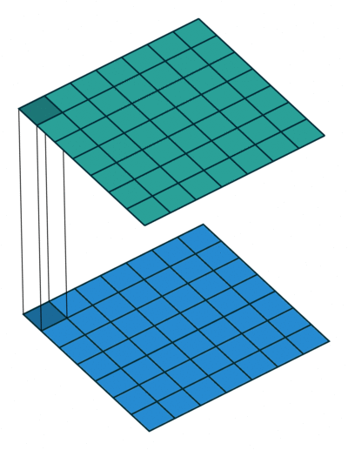
CNNs in Practice
1x1 convolutions are a special case
Convolve the feature maps, rather than the pixel maps
Function as a dimensionality reduction step (like pooling)
Can also be used in pooling

Slide 20
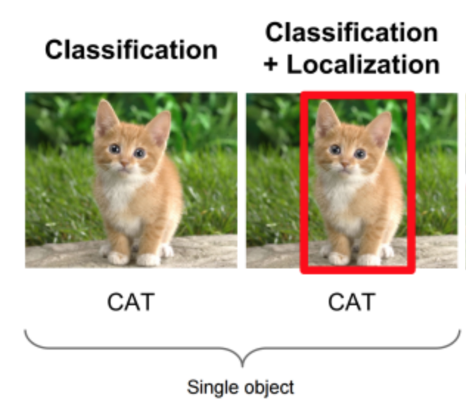
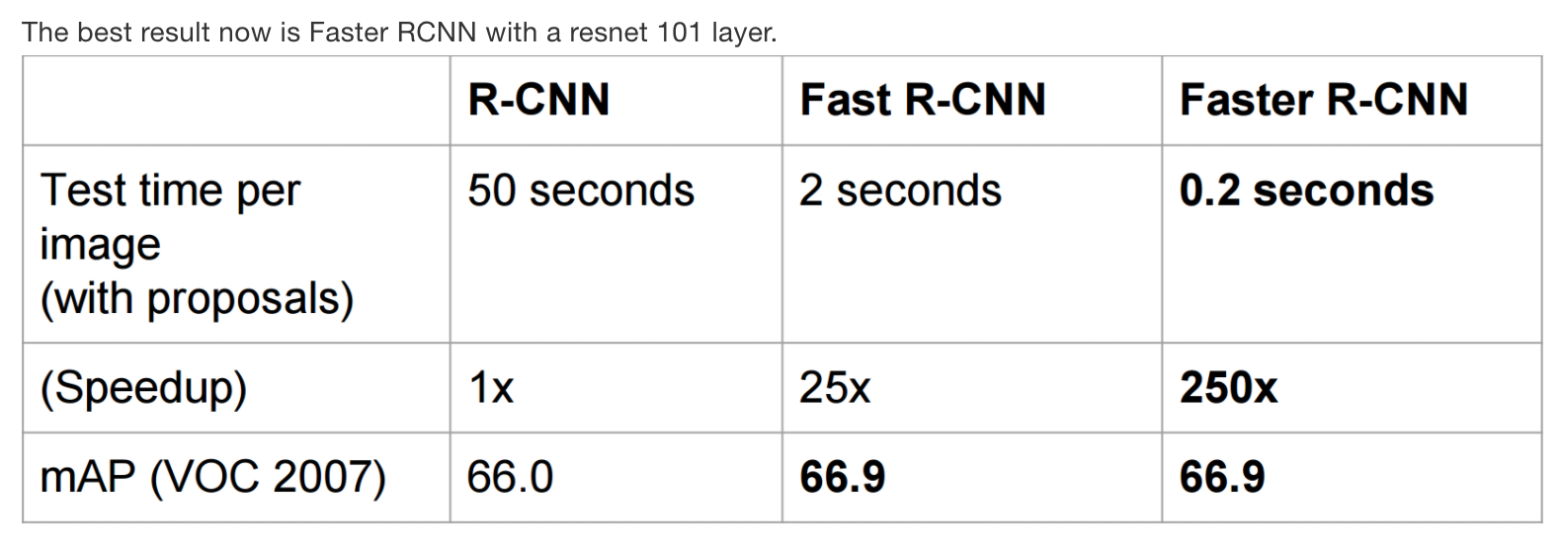
CNN Applications: Object Localization
Two discrete steps:
Localizing a bounding box (regression)
Identifying the object (classification)
Generate “region proposals”
Classification accuracy
Notes:
Real-world applications of CNNs (can probably list these off yourselves!)

Slide 21
CNN Applications: Single-shot Detection
Combines region-proposal (regression) and object detection (classification) into a single step
Use deep-level feature maps to predict class scores and bounding boxes
Families of Single-shot detectors:
YOLO (single activation map for both class and region)
SSD (different activations)
R-FCN (like Faster R-CNN)

Slide 22
CNN Applications: Object Segmentation
Create a map of the detected object areas
“Fully-convolutional” networks
Substitute fully-connected layer at end for another convolutional layer
Activations show object
Resolution is lost in upsampling step
Skip-connections to bring in some of the “lost” resolution
EXTREME Segmentation
Replace upsampling with a complete deconvolution stack

Slide 23
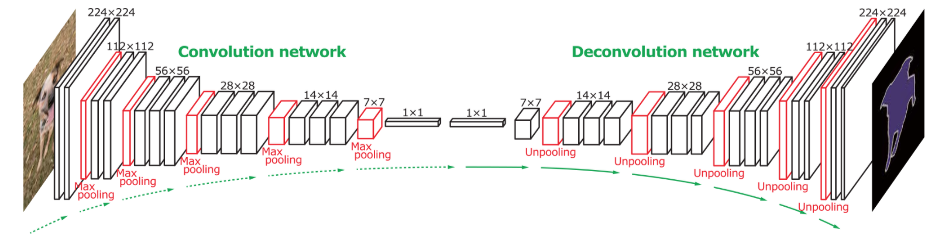
CNN Applications: Object Segmentation
“DeconvNet”: Super-expensive to train
But results are excellent
Particularly for small objects

Slide 24
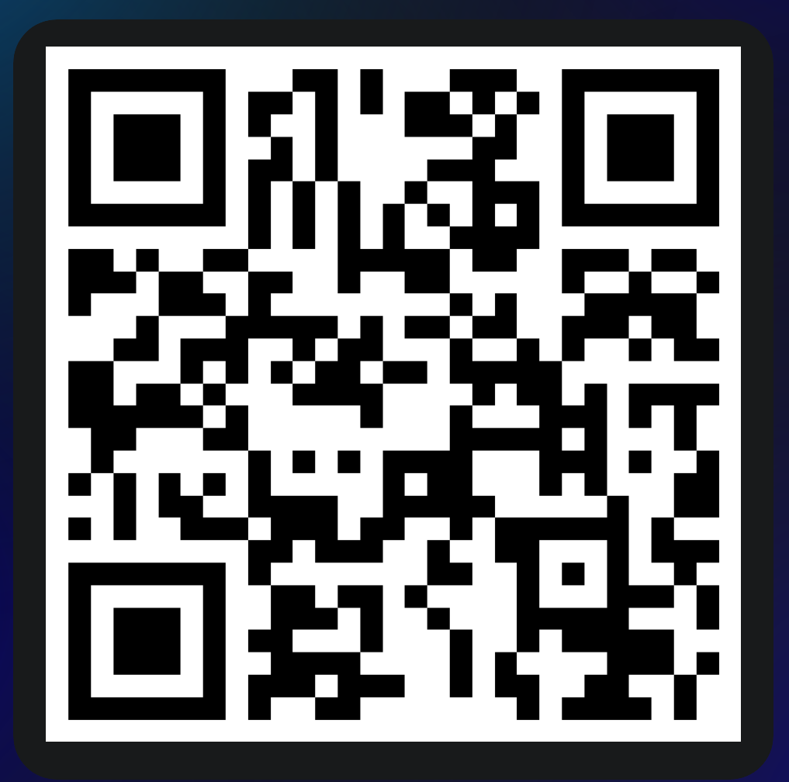

Slide 25
Conclusions
CNNs are mostly “convolutions inside a deep network”
Main operator (i.e. most important) is the convolution
Exploits image sparsity: important features are local
A couple new[ish] tricks include
Automatically learning the filters as part of the training process
Using pooling
1x1 convolutions
Applications include
Object detection (is there an object)
Object localization and segmentation (where is the object)
Object classification (what is the object)
Zero- and single-shot detectors

Slide 26
References
The Neural Network Zoo
http://www.asimovinstitute.org/neural-network-zoo/
Deep Learning Book, Chapter 9: “Convolutional Networks”
http://www.deeplearningbook.org/contents/convnets.html
Convolution Arithmetic code (for generating awesome gifs)
https://github.com/vdumoulin/conv_arithmetic
1x1 Convolutions
https://iamaaditya.github.io/2016/03/one-by-one-convolution/
AI Gitbook
https://leonardoaraujosantos.gitbooks.io/artificial-inteligence/

